Slide 1
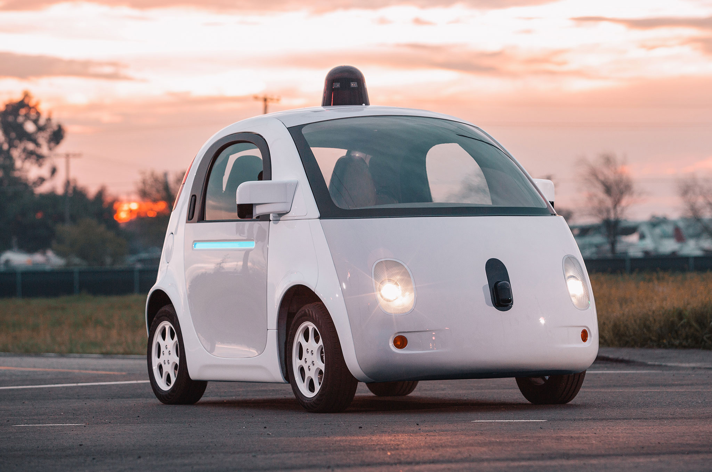
PEACE Passenger Emotion Analysis for Commute Enhancement
'; DROP TABLE TEAM; --
Jinwoo Yom
Chaeyoon Lee
Luv Sampat
Mohannad Ibrahim

Slide 2


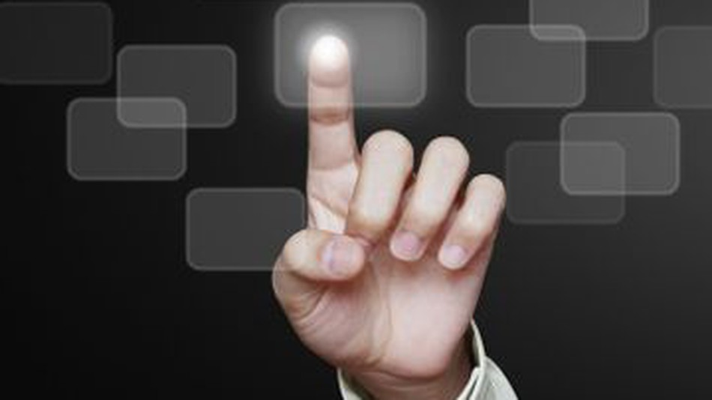
Problem
Public Acceptance
Ride Quality
Interface
How to gain and retain trust?
How can it be measured?
Which interface and technology to use?

Slide 3


Slide 4
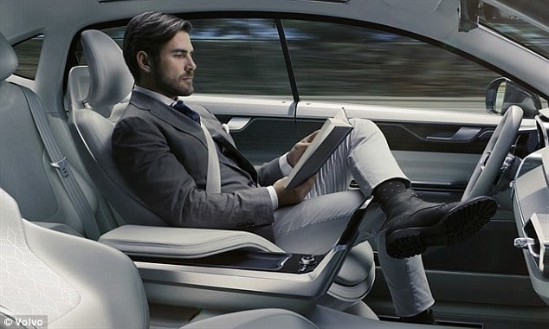


Solution
Capture
Detect
Periodic images storage
Multiple facial detections
Analyze
Action
Precise emotion analysis
Interpret, confirm, execute

Slide 5
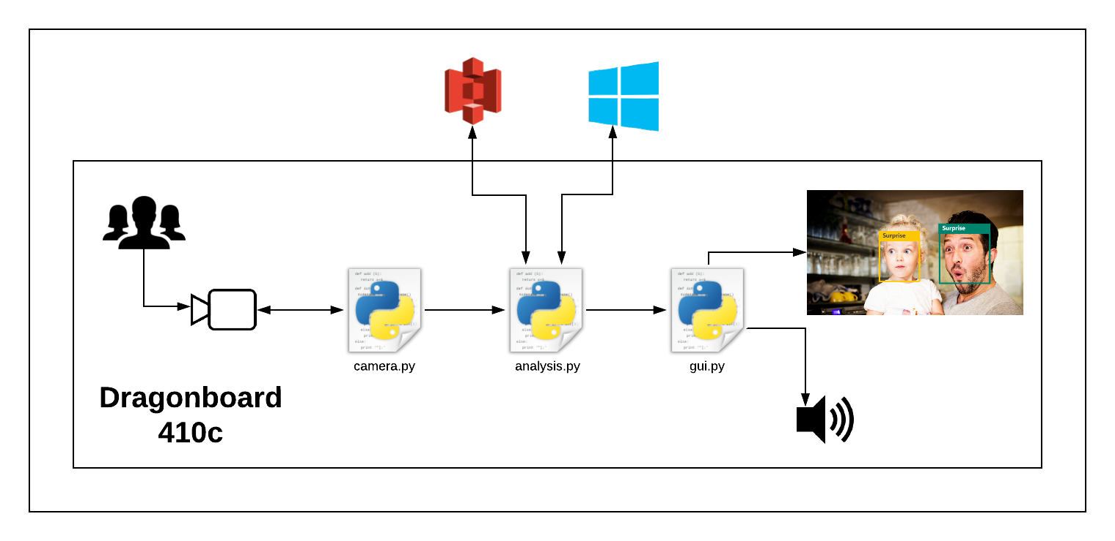
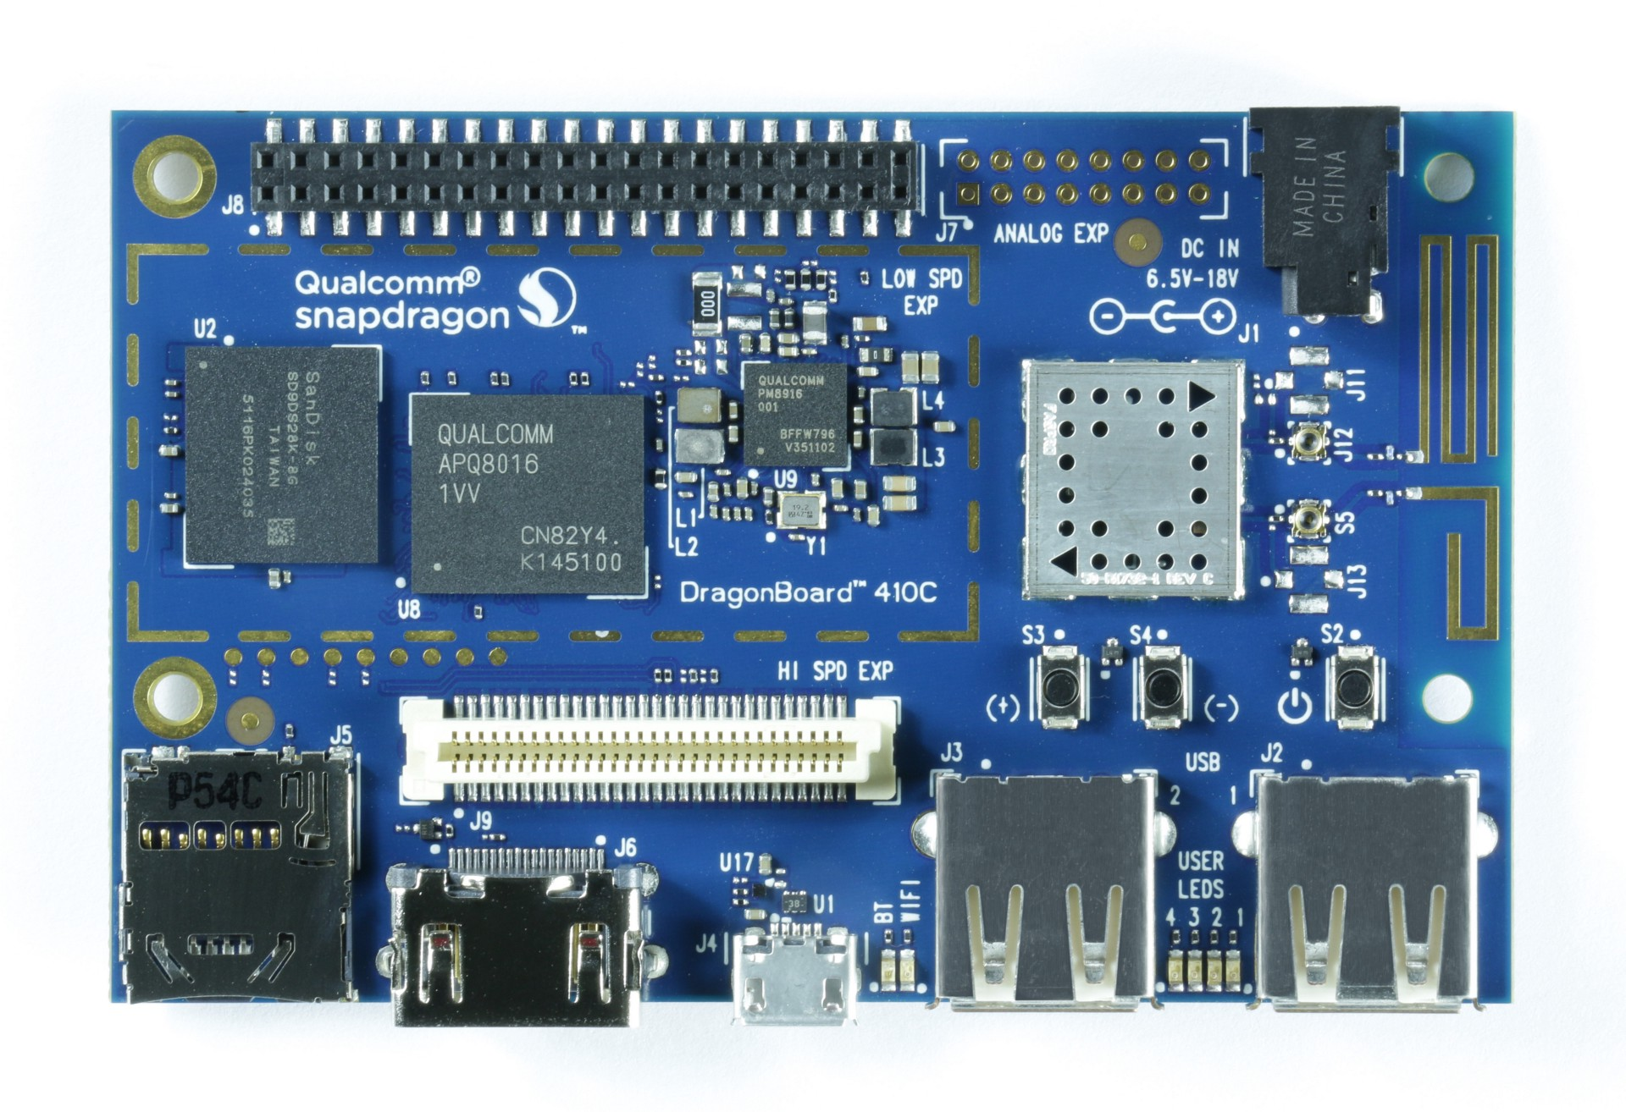
Overview

Slide 6
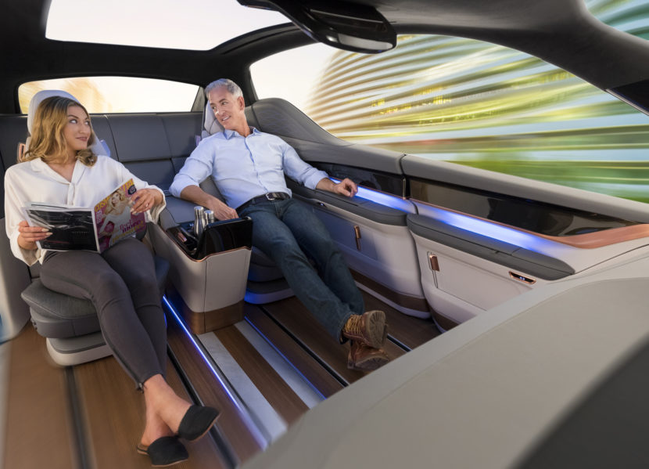
Future Plans
Rideshare application
Reliable emotion detection
Qualcomm’s Drive Data Platform
Minimize false positives
Further sensor integration
Notes:
Before
Qualcomm’s Drive data platform
Smarter route selection
Eliminate false positives
More Applications
Emotions in the dark
Now
Currently, we have 5 main goals for PEACE
Qualcomm’s Drive data Platform
to benefit Qualcomm’s effort towards improving Autonomous vehicles
Rideshare application
To maintain positive experience for both passenger and the driver
Reliable emotion detection
To further it’s practicality
Minimize false positives
To further eliminate risk and promote assurance
Further sensor integrations
such as GPS & temperature sensors to better pinpoint the source of passenger emotion
For example, just because a passenger is frustrated, it doesn’t mean the vehicle is driving poorly. It could mean that the car is too hot inside
So guys, we are very excited about the future of autonomous vehicles. And with PEACE we hope to make it a step closer to reality.
Thank you for your time, we’ll be happy to take any questions ☺

